Slide 1

DriverPass System Analysis
Jose Soqui
Notes:
[No speaker notes required for this slide.]

Slide 2

System Requirements
Functional requirements : Admin Modules and Content Management
Nonfunctional requirements: Manageability and reliability
Notes:
[In your speaker notes, include an explanation of the different requirements you determined for DriverPass’s system. What are the functional requirements you selected to describe? What are the nonfunctional requirements you selected to describe? Be sure to explain how these requirements meet DriverPass’s needs.]

Slide 3
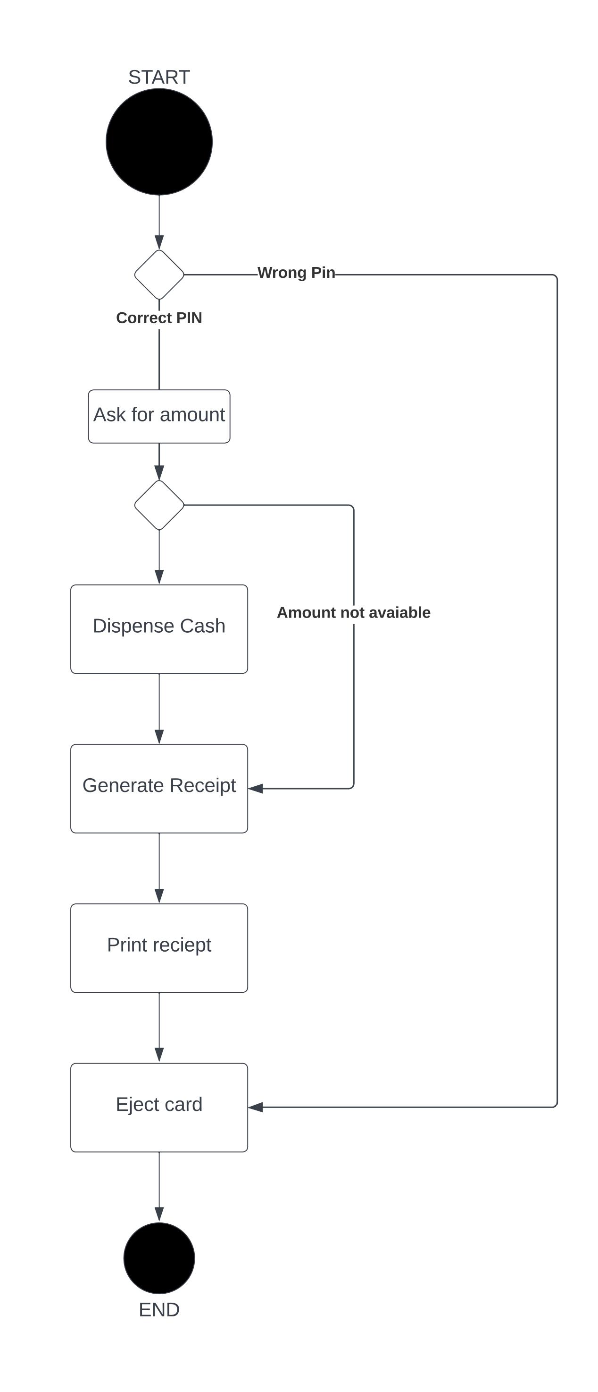
Use Case Diagram
Notes:
[Explain your diagram. Who are the different actors in the system? What are the different use cases? How did you account for DriverPass’s needs in your design? In your explanation, keep your audience in mind. Avoid the use of terms like “actors” and “use cases” in your explanation.]

Slide 4
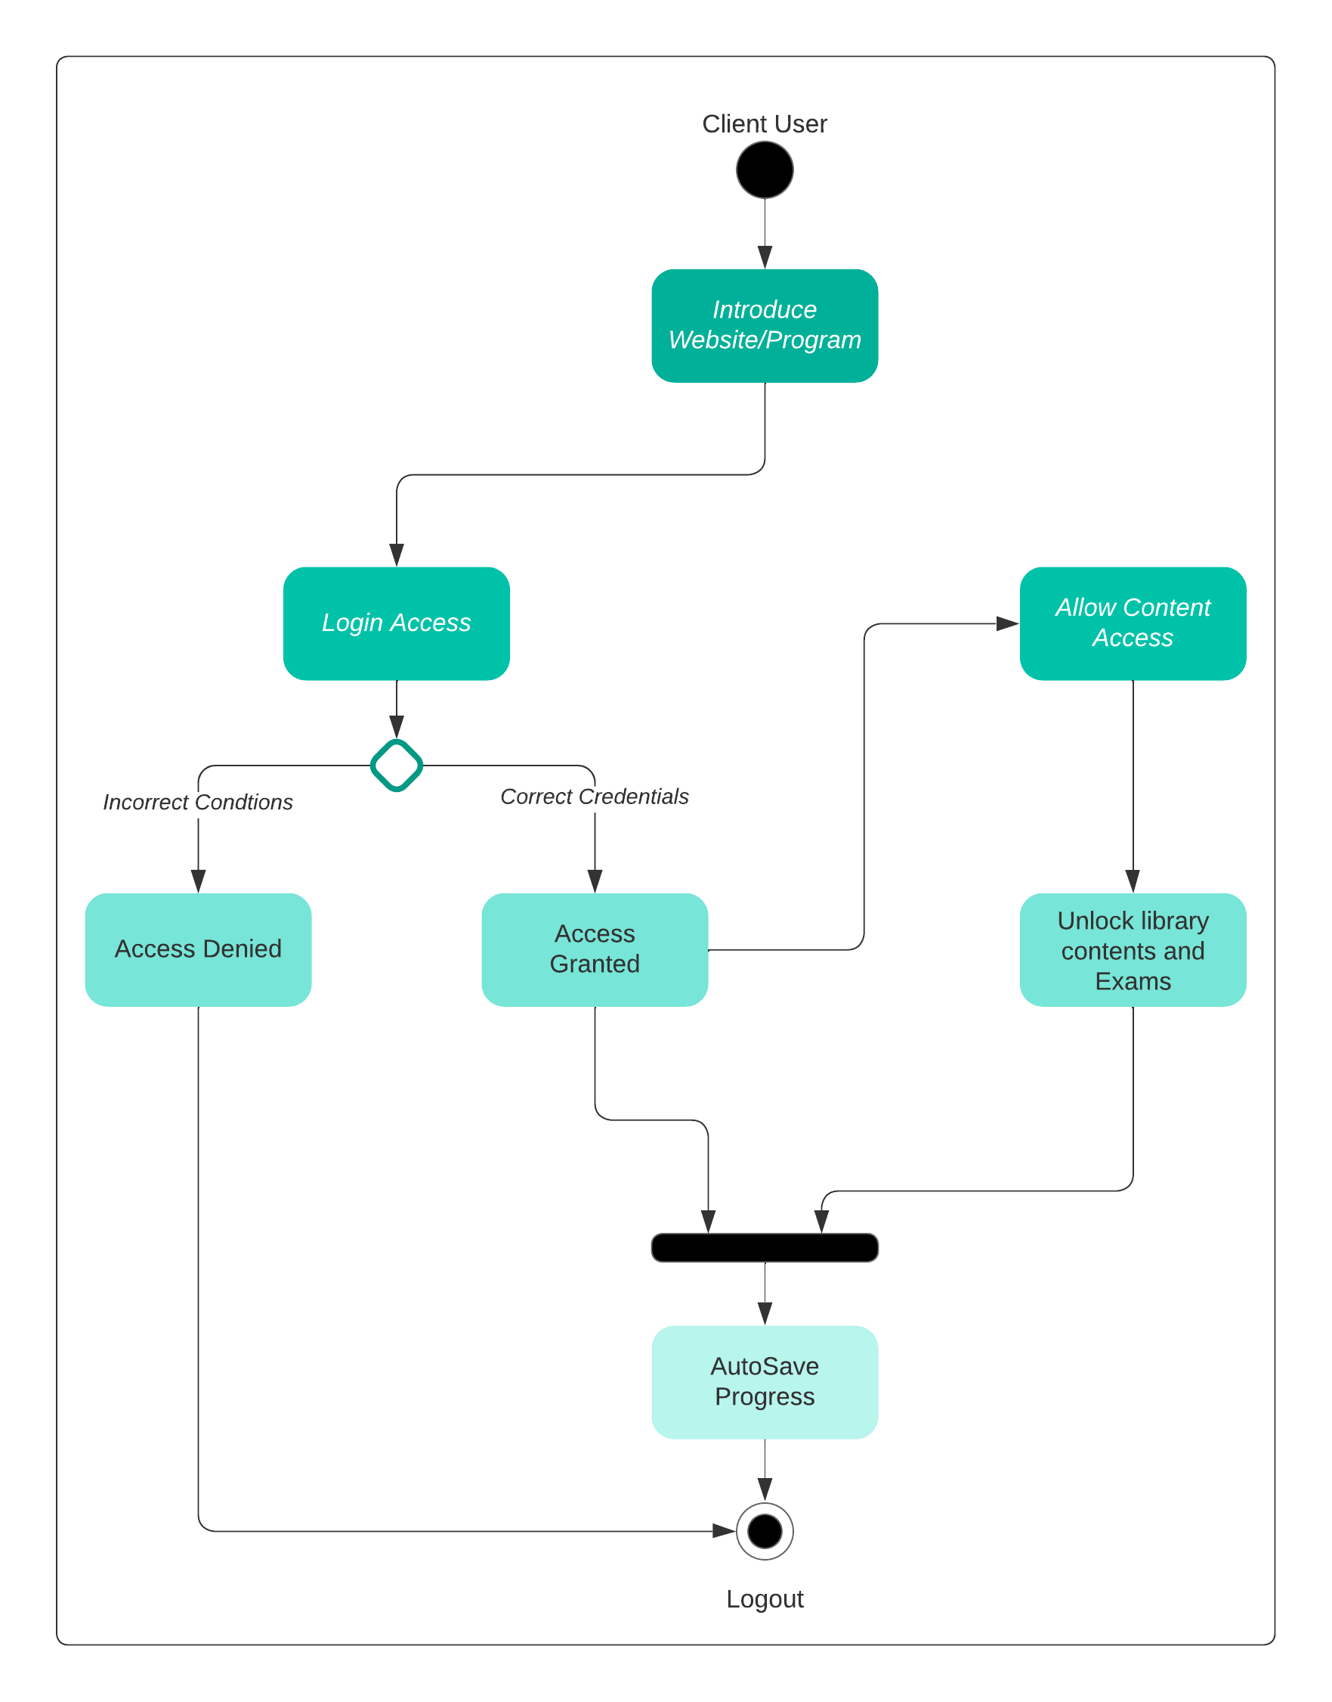
Activity Diagram
Notes:
[Explain your diagram. Which use case are you breaking down? What are the steps for this use case? How did you account for DriverPass’s needs in your design? In your explanation, keep your audience in mind. Avoid the use of technical terms such as “nodes,” “control flows,” and so on.]

Slide 5
Security
Possible concerns when dealing with security are the following:
Data security
Access protocols
IT management
Data access
Content supervision
Notes:
[How did you consider security in your design? In your explanation, keep your audience in mind by avoiding the use of technical terms.]

Slide 6
System Limitations
The two main concerns regarding this project are Information availability and Accessibility when making this kind of project into an application.
Notes:
[What are the limitations of your design? In your explanation, keep your audience in mind by avoiding the use of technical terms.]

